Slide 1
Amazing Title Goes Here
Awesome Subtitle
Presenter Name, Job Title

Slide 2
Welcome to Liferay Symposium
Things to do in Paris, France
  See the Eiffel Tower
    Take lots of pictures
  Visit The Louvre
    Send a postcard

Slide 3
1
2
3
Focusing on the Omnichannel Experience
Providing Personal Insight and Wisdom for Financial Needs
Finding Ways to Improve Margins and Productivity

Slide 4
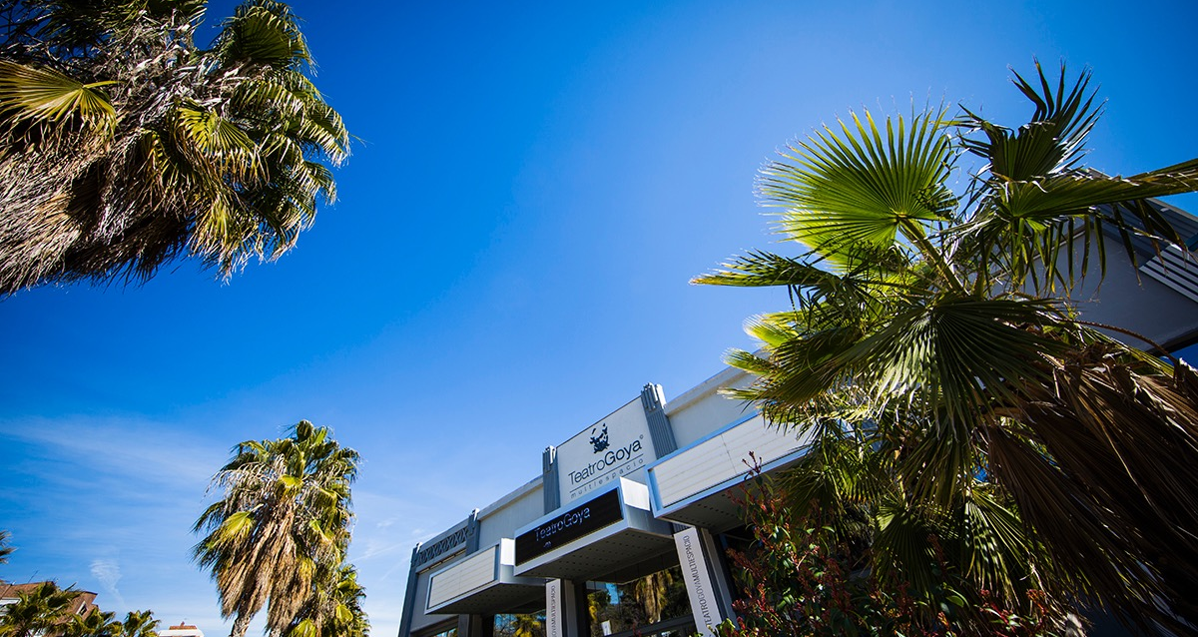
Spain Symposium 2017

Slide 5
“Liferay’s software helps you develop great customer experiences and modernize business operations.”

Slide 6
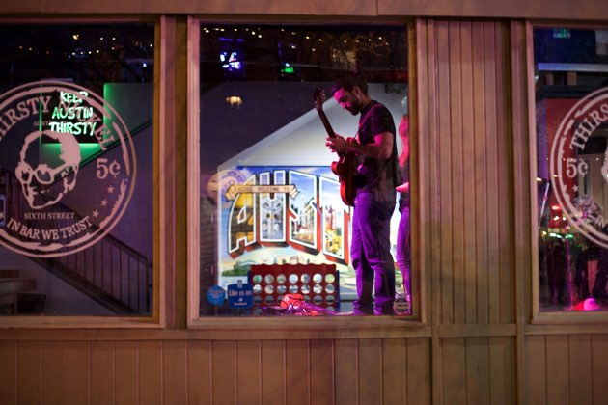

Listening to Music in Austin!
Sixth Street
Congress Street

Slide 7
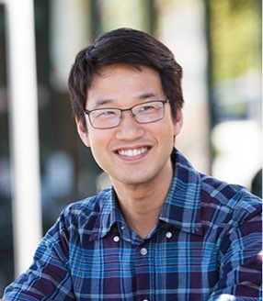
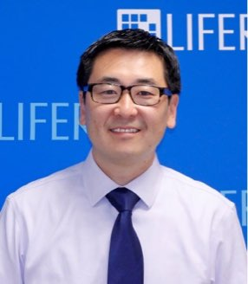
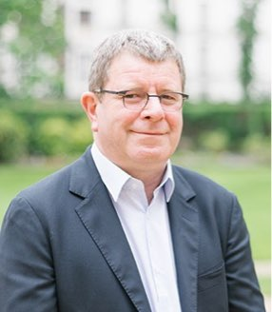
Bryan Cheung
CEO & Founder,
Liferay
Edwin Chung
VP of Product Management,
Liferay
Franck Verbeke
General Manager France,
Liferay

Slide 8
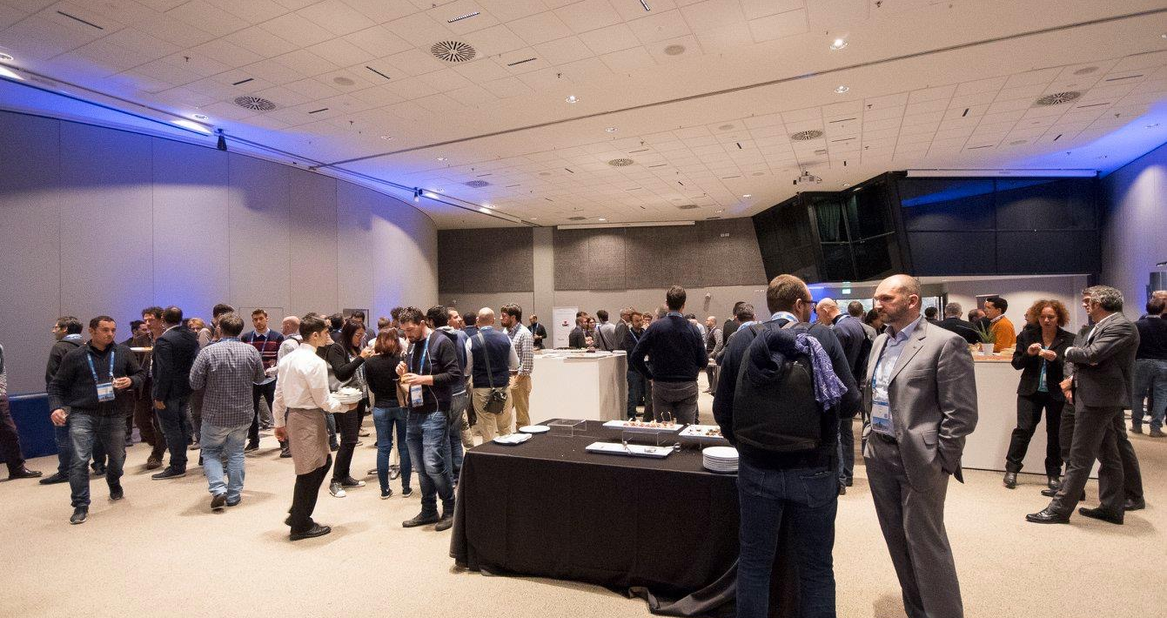
Fun Facts
If you counted for 24 hours a day, it would take over 31,000 years to reach one trillion.
There are 293 ways to make change for a dollar

Slide 9



Cocktail de networking
Rencontre avec les experts Liferay
Sessions techniques

